Slide 1

AOLME Curriculum SESSION 4
MATERIALS DEVELOPED BY THE AOLME PROJECT AT THE UNIVERSITY OF NEW MEXICO, PLEASE DO NOT COPY OR DISTRIBUTE ANY OF THESE COPYRIGHTED TASKS WITHOUT PROPER AUTHORIZATION

Slide 2


Level 1
SESSION 1: Basic of Raspberry PI and Linux-(motivational overview of projects-images, ls, cd, to find previously made files) SESSION 2: Introduction to Python (print, for, if) SESSION 3: Algorithms (for loops-arithmetic progressions, if statements-ranges, inequalities) SESSION 4: Binary and Hexadecimal number systems SESSION 5: The Coordinate Plane and Black & White Images in Python SESSION 6: Images and Their Components (histograms) SESSION 7: Creation of Images and Video FINAL PROJECT: VIDEO

Slide 3
BINARY & HEXADECIMAL NUMBER SYSTEMS
OBJECTIVES:
Develop connections and number sense across decimal, binary, and hexadecimal systems.
Identify real-world applications of binary numbers.
Convert number values across systems.

Slide 4

Selected ACTIVITIES
1. How do Decimal & Binary Numbers work?
2. Comparing Binary and Decimal Numbers
3. Hexadecimal Numbers

Slide 5
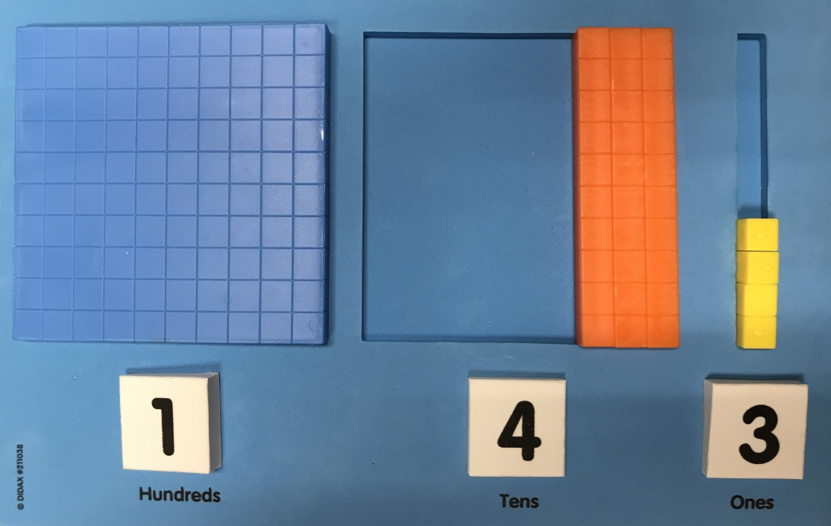

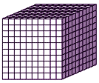
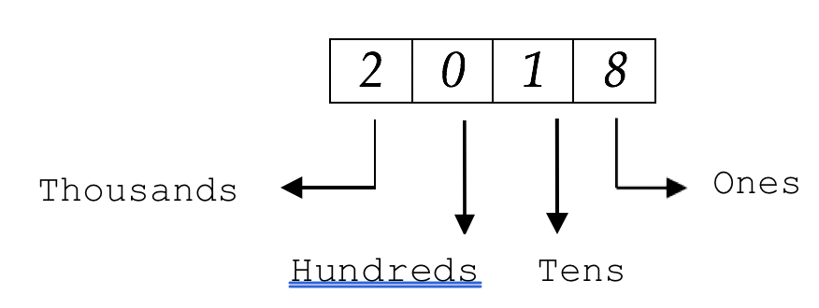


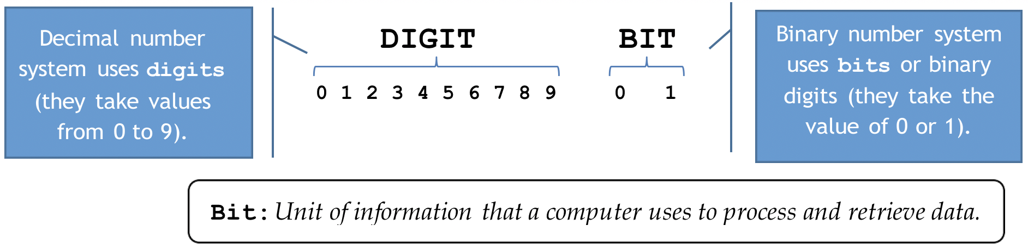
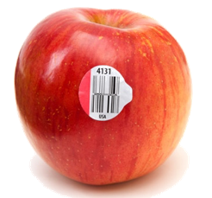
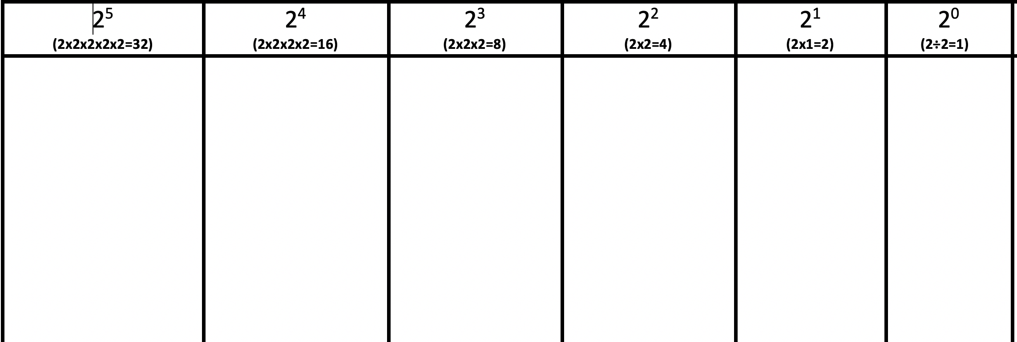
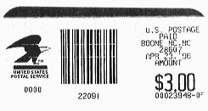
4.1. How do Decimal & Binary Numbers work?
1. Decimal Numbers: We use base-ten or decimal numbers all the time. For example, we are in the Year 2019. How would you represent 2019 using blocks?
2. Investigate: What’s wrong with the picture?
The place of a number affects its value!!
In your team, take turns coming up with a decimal number and representing it using the blocks as the picture on the right shows. Describe why you did it.
9
Each symbol, number, or digit has a value
How come Decimal numbers grow in groups or exponents of ten?
3. Think Binary Numbers: What do you know about binary numbers? Why are these binary numbers?
4. Explore: Binary numbers with only ones and zeros create any value. Explore patterns of how the blocks representing binary numbers grow. How are the patterns and exponents related?
What’s an exponent?
Complete Table 1 using blocks. Zeros turn off & Ones turn on the values of the column wherein they are placed. Why do you think it is so? For example, the binary number of 101₂ is equivalent to the value of the decimal number of 5₁₀. Why?
AOLME PROJECT - LEVEL 1- SESSION 4- 2019
MATERIALS DEVELOPED BY THE AOLME PROJECT AT THE UNIVERSITY OF NEW MEXICO, PLEASE DO NOT COPY OR DISTRIBUTE ANY OF THESE COPYRIGHTED TASKS WITHOUT PROPER AUTHORIZATION

Slide 6
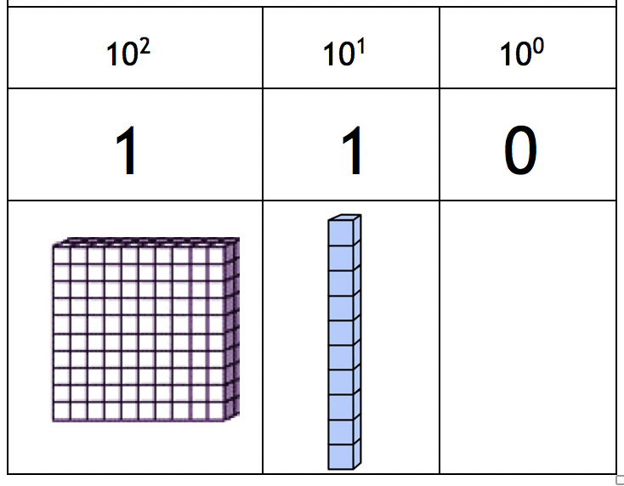
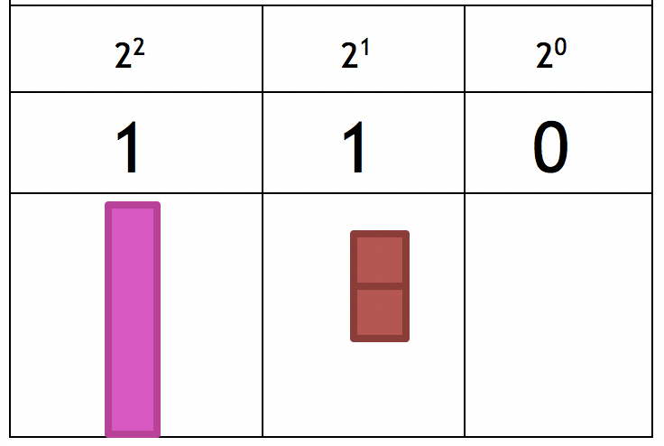
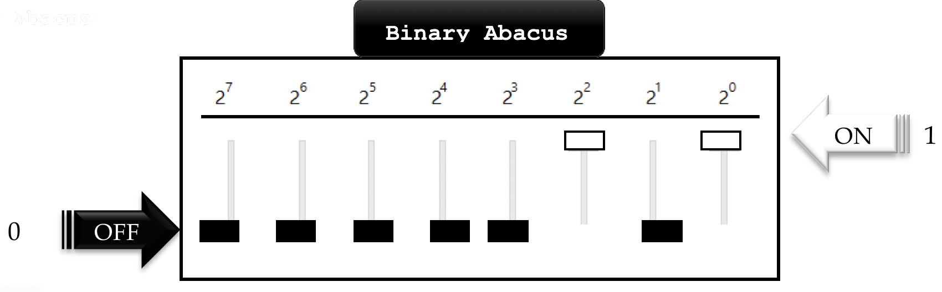
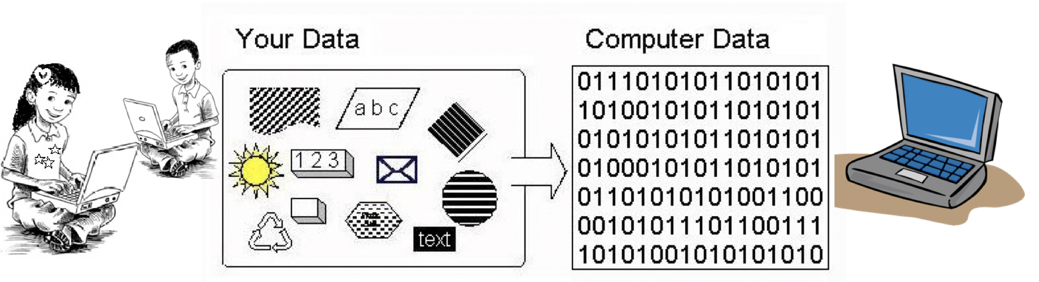


4.2. Comparing Binary and Decimal Numbers
Practice: in Table 1 using blocks and binary digits (1 & 0) represent binary numbers taking turns. Then, represent the same value using decimal blocks/numbers.
Compare: These numbers look the same, but they don’t have the same value. On the left are decimal numbers and on the right binary.
Which is worth more?
Play: Come up with a binary number and have your peers find out its value.
3. Represent Binary Abacus with the Binary Abacus on your laptop desktop. Take turns creating binary numbers by switching values on (1) or off (0). Write them down and justify how place of a digit affects its value.
4. Practice: Using the handout: Creating, Writing and Comparing Numbers, work in pairs and compare results of conversions. Check answers in Binary Abacus.
Why is it important to understand binary numbers when working with computers?
AOLME PROJECT - LEVEL 1- SESSION 4- 2019
MATERIALS DEVELOPED BY THE AOLME PROJECT AT THE UNIVERSITY OF NEW MEXICO, PLEASE DO NOT COPY OR DISTRIBUTE ANY OF THESE COPYRIGHTED TASKS WITHOUT PROPER AUTHORIZATION

Slide 7
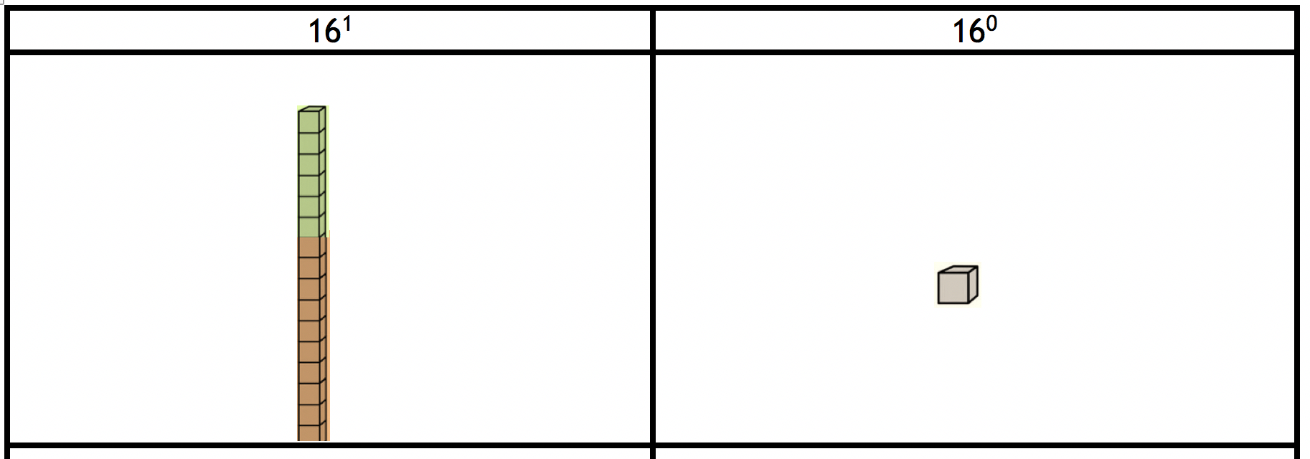
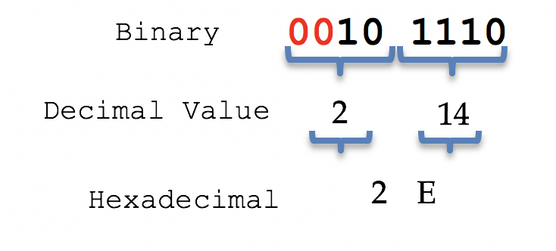

4.3. Hexadecimal Numbers
What base are these number notations in?
111₂ A0₁₆ 1010 1A₁₆
Create your own number system notation!
“Hexadecimal” means Hexa-(six) plus decimal (ten), or sixteen, or “based 16.”. People also call them Hex. Hex numbers have16 hexadecimal digits (or nibbles). To represent them we use the symbols below:
Hex grow in groups of 16. What’s the value of 2A₁₆ and A2₁₆?
In Table 2 Take turns, using the hex blocks, digits to represent hex numbers. Remember, place matters!
How would you write 16 in Hex?
Use decimals numbers to write on board the value of each number:
10 (decimal): ___, 10₂ (binary): ___, 10₁₆ (hexadecimal): ____
11 (decimal): ___, 11₂ (binary): ___, 11₁₆ (hexadecimal): ____
These are some Hex numbers: 51₁₆ A3₁₆ F8₁₆ BD₁₆
3. Conversions: Binary ➔ Hexadecimals
Hex help write binary numbers easier by grouping binary numbers in bits or sets of 4 binary digits. Each bit can be represented with a hex. For example, 101110₂:
4. Challenge: Now that you have learned new numbers systems, complete handout, Table 3. This table might help remember in the future how these numbers work.
Using Table 2.1 on the back of the Binary table, take turns converting binary into Hex numbers. Follow similar procedures to these ones:
Why do you think these procedures work?
Write about what you learned in Session 4. For example, write sentences that start with:
-Digits of binary numbers are …
-Exponents are numbers that … They mean …
-Hex and binary numbers are different in…
AOLME PROJECT - LEVEL 1- SESSION 4- 2019
MATERIALS DEVELOPED BY THE AOLME PROJECT AT THE UNIVERSITY OF NEW MEXICO, PLEASE DO NOT COPY OR DISTRIBUTE ANY OF THESE COPYRIGHTED TASKS WITHOUT PROPER AUTHORIZATION

